Slide 1
Integration Project
Design and development of a web and mobile
training management application
College year : 2022/2023

Slide 2
Our team
Dhia Trabelsi
Sameh Kouki
Yesser Rahal
Mohamed lahbib

Slide 3
Presentation Plan
01
General Introduction
04
System Design
02
Preliminary Study
05
Production
03
Specification of needs
06
General Conclusion

Slide 4
General Introduction
To master the technologies we learned throughout this semester, we decided to practice them in a real life project .
Our mission for this project revolves around the development of a web and mobile application that helps students to be assigned to trainings .

Slide 5
Preliminary Study

Slide 6
Description of the existing
While discussing between us we noticed that there are problems at the level of management of the training in our institute, especially the training of the clubs.
Those problems will affect mediating training in order to obstruct them.

Slide 7
Criticisms of the existing
The institute page is a globally administrative page so publish these events in which it is not possible to ensure that they will be seen by the students.
In each event the administration does not manage to know the exact number of students who will participate and their data .

Slide 8
Methodology and modeling adopted
UML
SCRUM
We used UML for modeling our system
We adopted Scrum as a methodology for our project

Slide 9
Specification of needs
In this chapter, we are going to present the functional and non functional needs of our system, take a look at the product BackLog, use case diagram and class diagram

Slide 10
01.
Functional needs

Slide 11

ADMIN
Authenticate
Manage trainings
Manage Trainers
Check offered trainings

Slide 12

TRAINER
Authenticate
Consult list of trainings
Offer trainings

Slide 13

STUDENT
Authenticate
Consult list of trainings
Register for trainings
Consult list of registered trainings

Slide 14
02.
Non functional needs

Slide 15

User friendly
Security
Availability

Slide 16
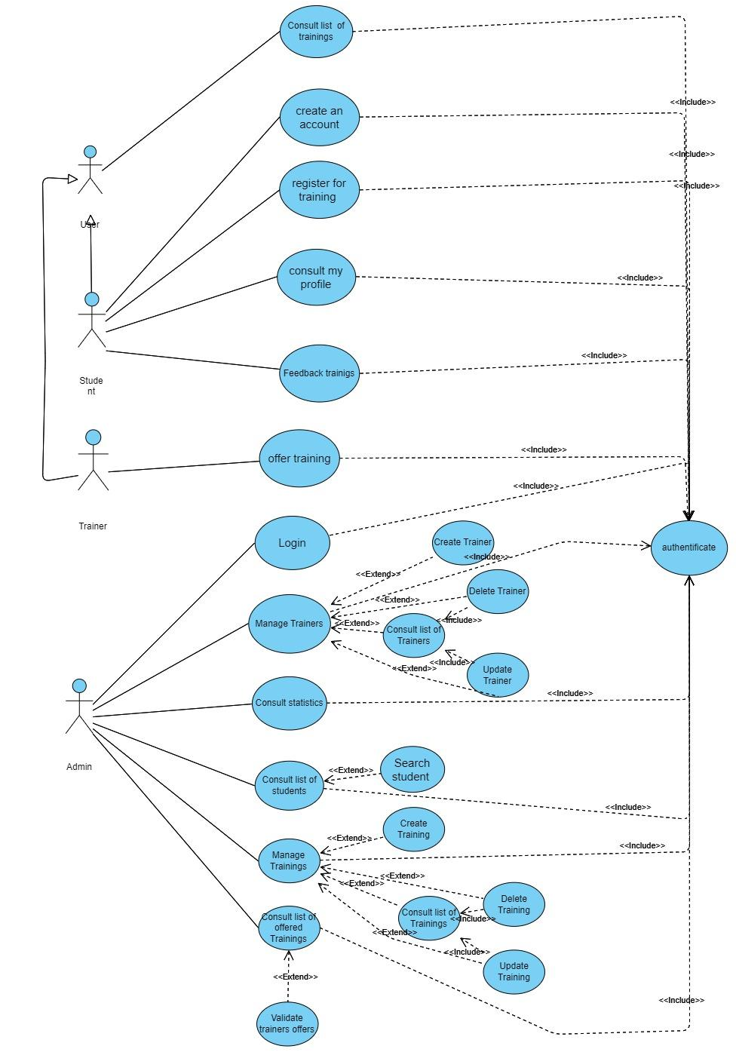
Use case
diagram

Slide 17
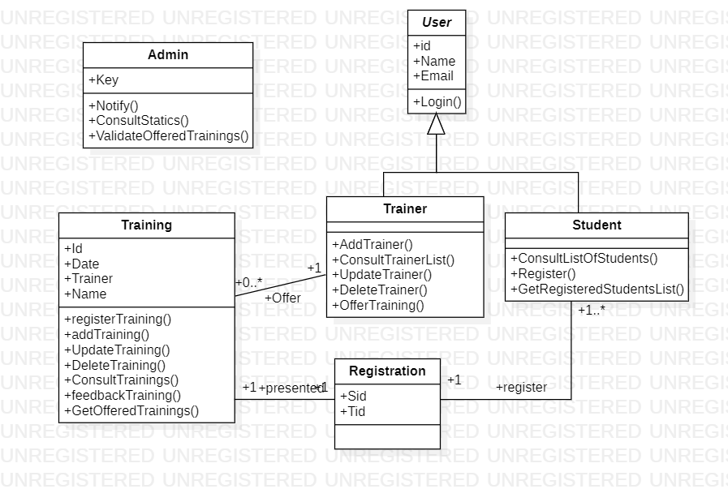
Class diagram

Slide 18
System design
In this chapter, we are going to talk about each sprint.

Slide 19
Product BackLog

Slide 20
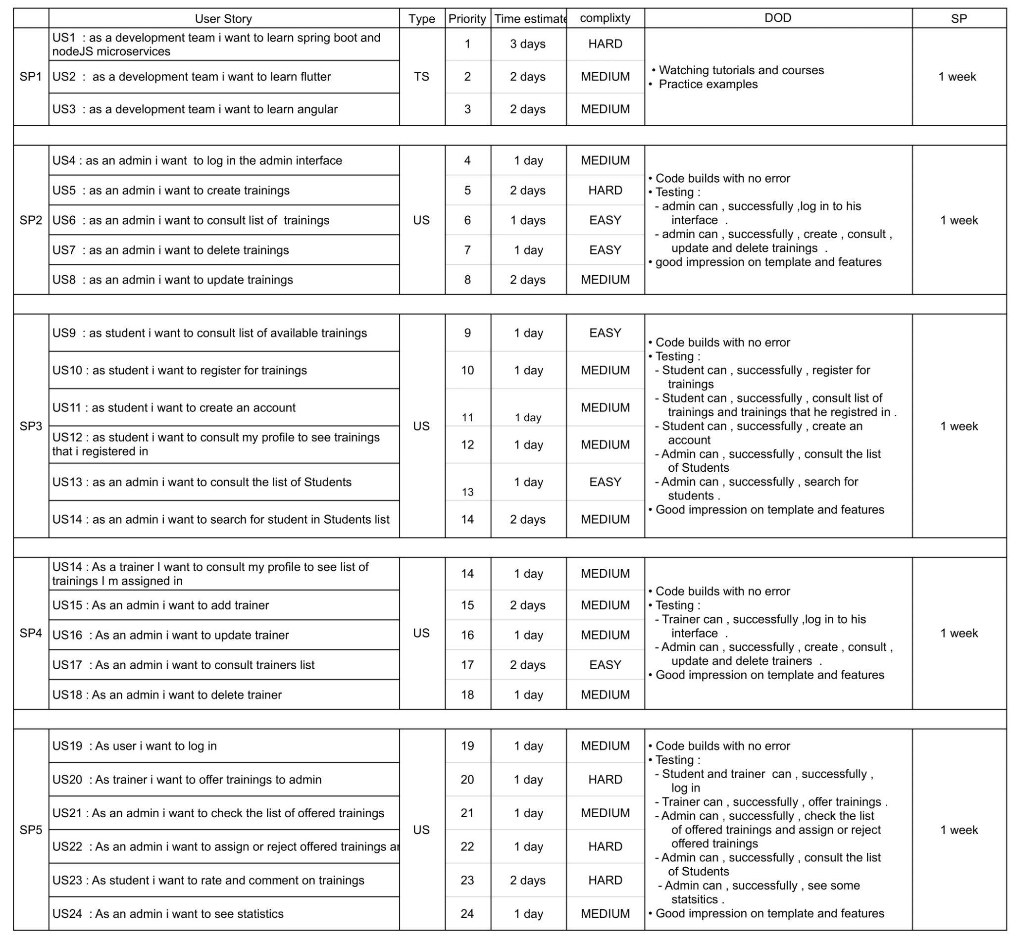

Slide 21
Sprint I
GOAL
admin can successfully log in to his interface
admin can successfully create , consult , update and delete training.

Slide 22
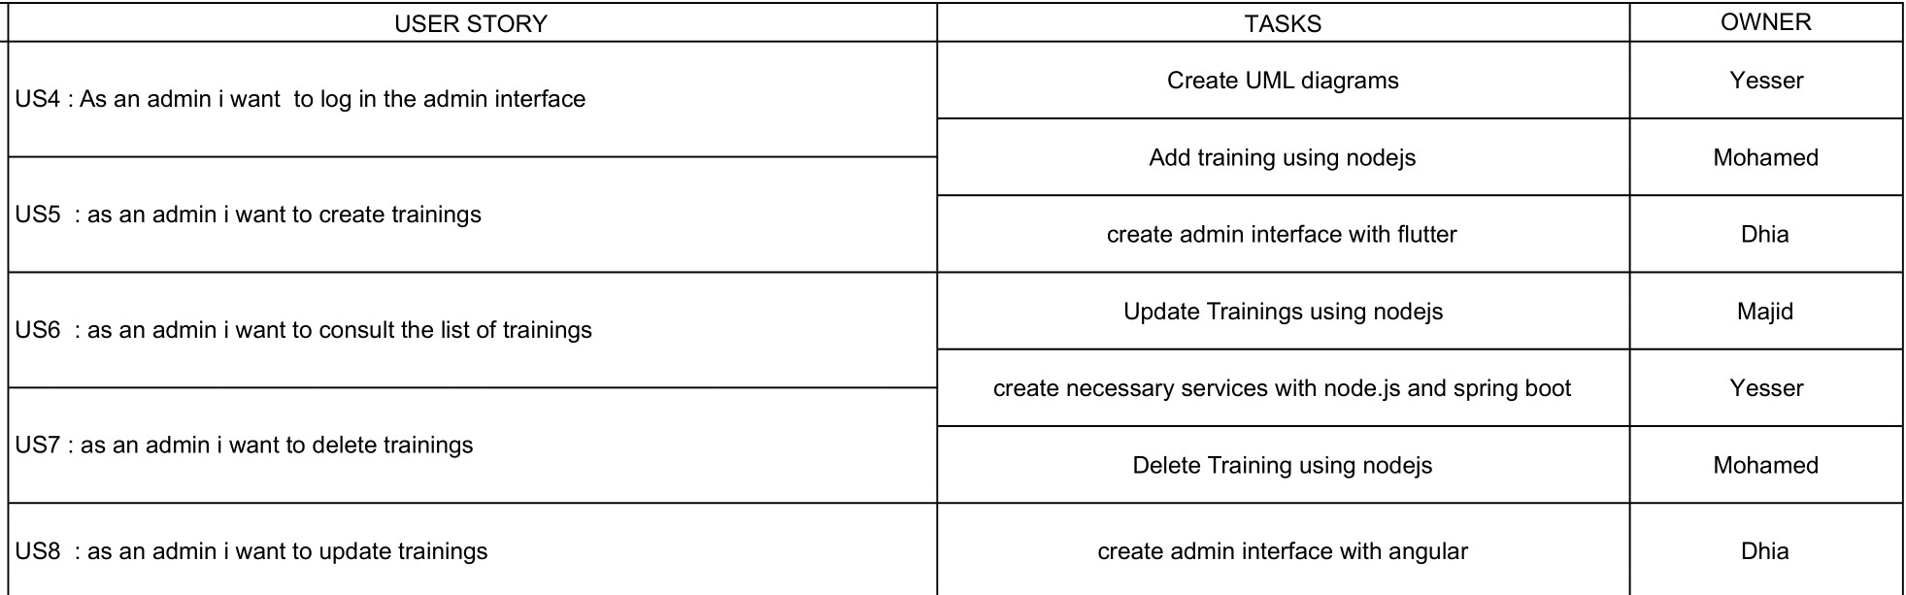
Sprint Backlog

Slide 23
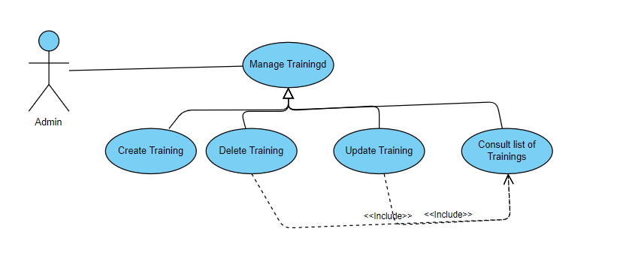
Use case diagram

Slide 24
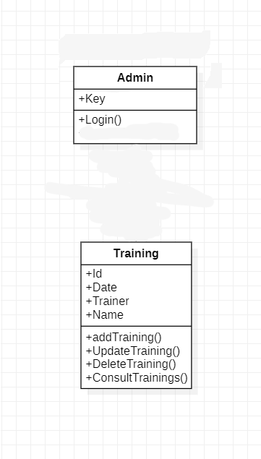
Class diagram

Slide 25
Sprint II
GOAL
Student can successfully create an account
Student can successfully consult list of trainings
Student can successfully register for trainings
Admin can successfully consult list of Students
Admin can successfully search for students

Slide 26
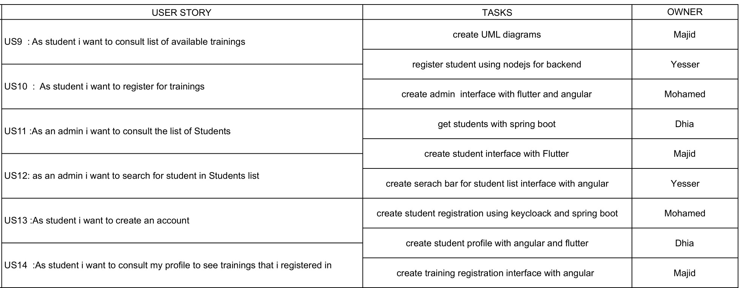
Sprint Backlog

Slide 27
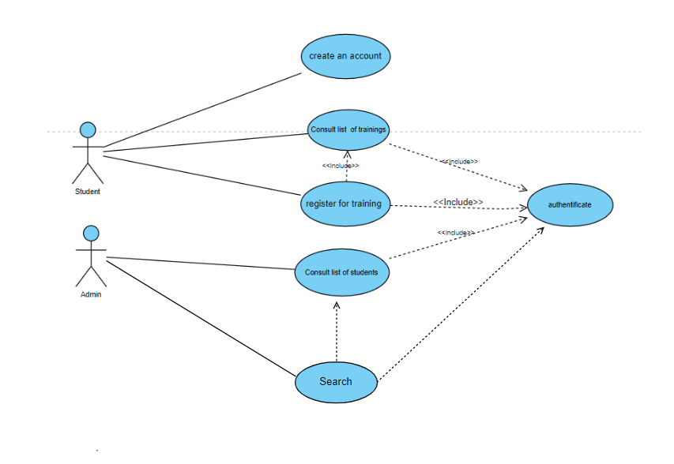
Use case diagram

Slide 28
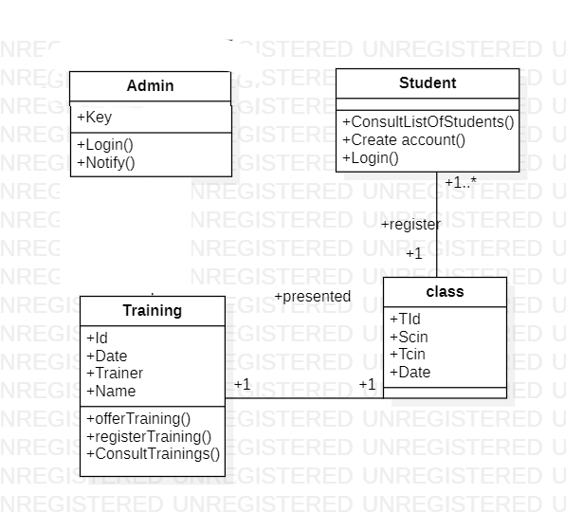
Class diagram

Slide 29
Sprint III
GOAL
Trainer can successfully log in to his interface
Admin can successfully create , consult ,update and delete trainers

Slide 30
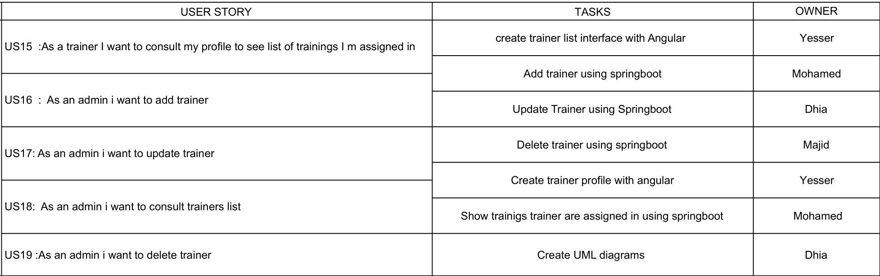
Sprint Backlog

Slide 31
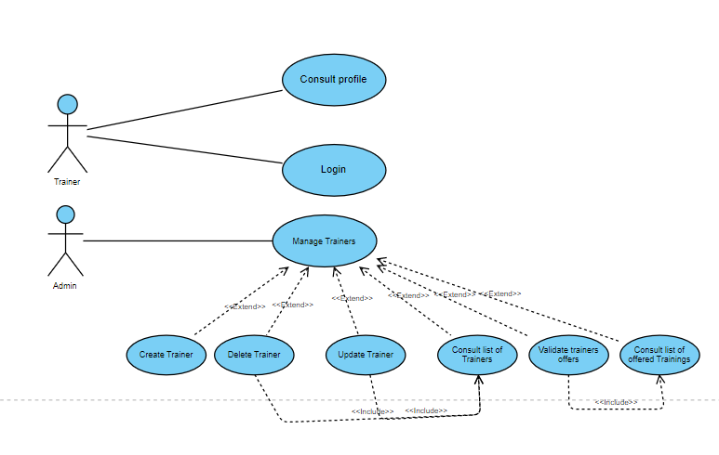
Use case diagram

Slide 32
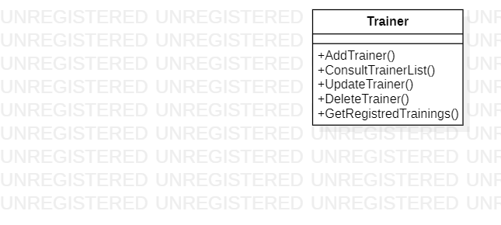
Class diagram

Slide 33
Sprint IV
GOAL
Student and trainer can successfully log in
Trainer can successfully offer training
Admin can successfully accept or reject offered trainings
Admin can successfully consult list of students
Admin can successfully see some statistics

Slide 34
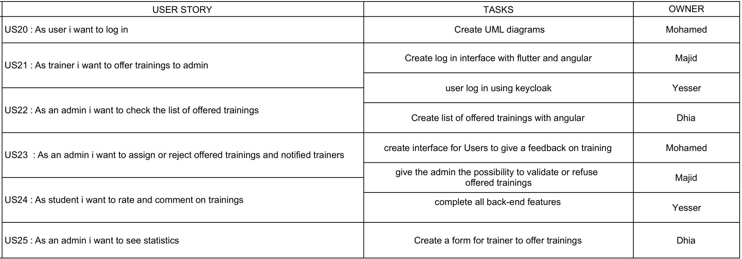
Sprint Backlog

Slide 35
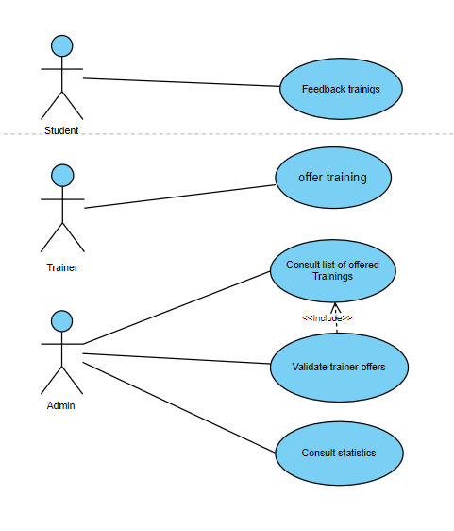
Use case diagram

Slide 36
Dynamic modeling

Slide 37
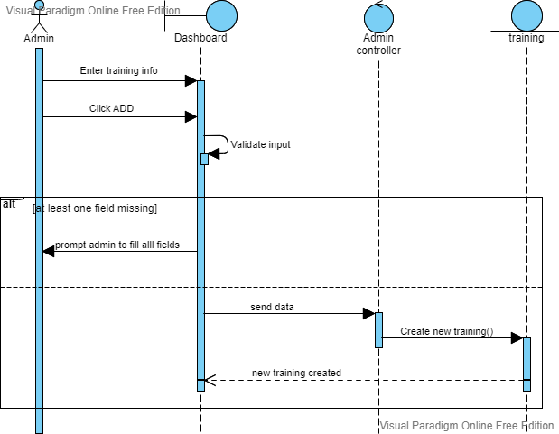
Add Sequence diagram

Slide 38
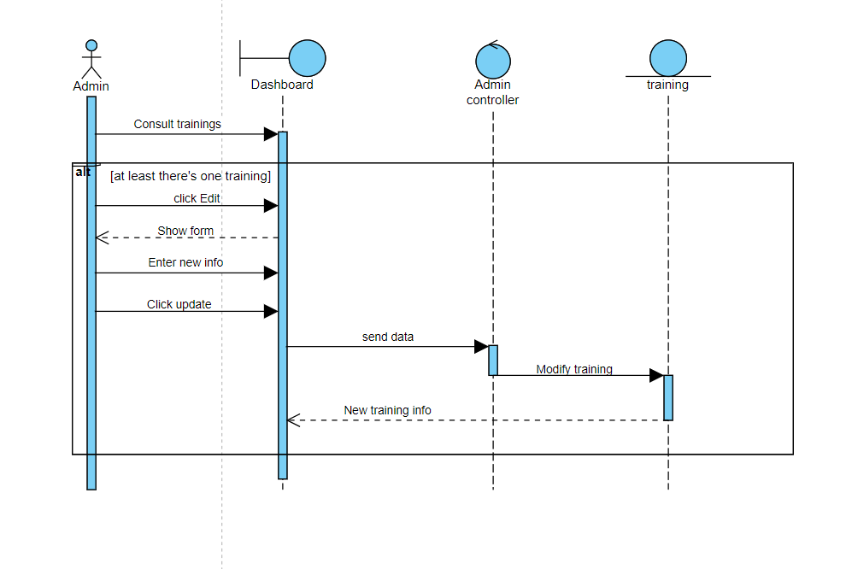
Update Sequence diagram

Slide 39
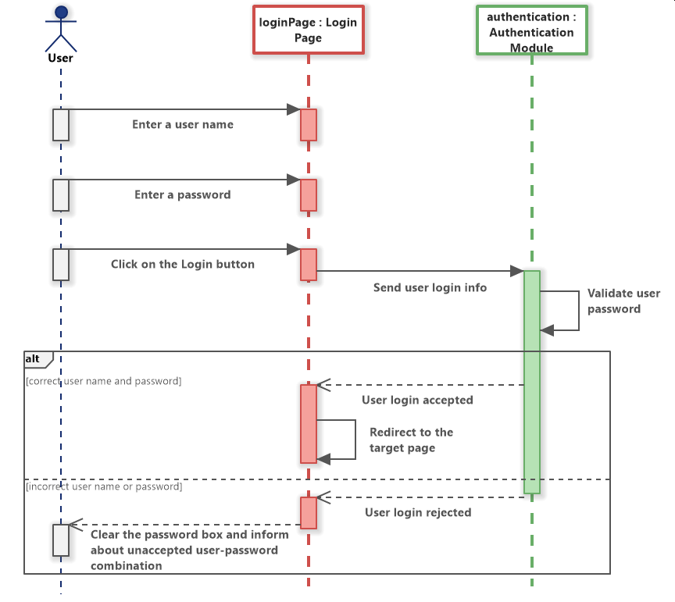
Login Sequence diagram

Slide 40
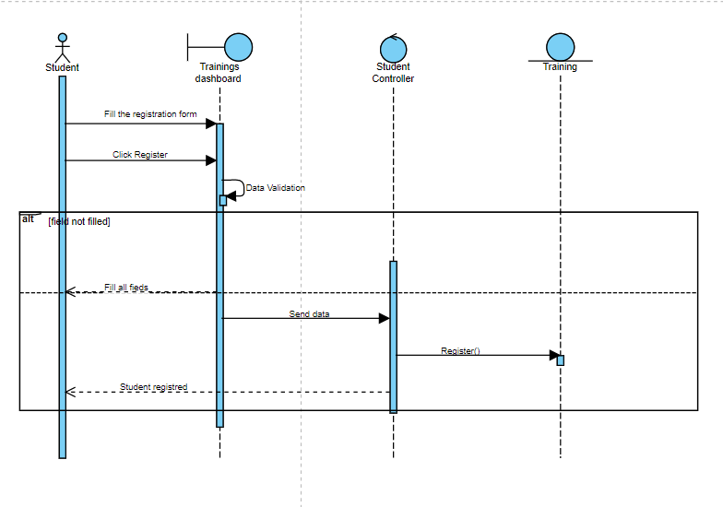
Register Sequence diagram

Slide 41
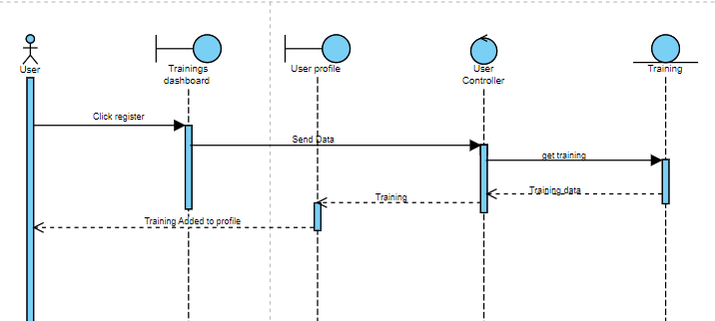
Register in training Sequence diagram

Slide 42
Production
In this chapter, we will talk about the work environment ,Hardware and software used for the production

Slide 43




Hardware
Lenovo
Asus
Asus
HP

Slide 44




Frameworks
Spring boot
Angular
ExpressJs
Flutter

Slide 45



DataBases
FireBase
MongoDB
MySql

Slide 46



Some tools
Postman
Jira
Visual Paradigm
For testing our APIs
For managing our backlog and sprints
For UML conception

Slide 47
00
Conclusion

Slide 48
In this project, we get to know more about microservices architecture and we get the chance to use multiple technologies for different parts of our application as backend, frontend and database.

Slide 49
Thanks!
Do you have any questions?

